Slide 1
Introduction to

Slide 2

Definition
Machine learning is an application of artificial intelligence (AI) that provides systems the ability to automatically learn and improve from experience without being explicitly programmed.
There is no need to “learn” to calculate payroll
Learning is used when:
Human expertise does not exist (navigating on Mars),
Humans are unable to explain their expertise (speech recognition)
Solution changes in time (routing on a computer network)
Solution needs to be adapted to particular cases (user biometrics)

Slide 3
Types of Machine Learning
Classification
Regression
Supervised Learning
Machine Learning
Reinforcement Learning
Semi supervised Learning
Unsupervised Learning

Slide 4
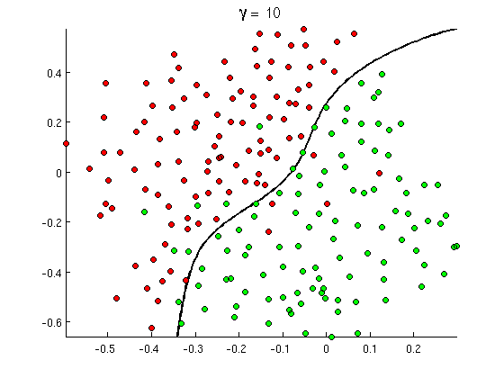
Types of Machine Learning
Classification
Regression
Supervised Learning
Classification
Regression
Supervised Learning
The goal of Classification is to predict a category or class y from some inputs x
Classification Applications
Spam detection
Medical diagnosis
Image classification
Sentiment analysis
…

Slide 5
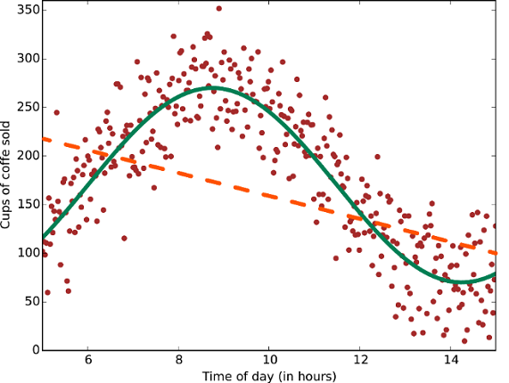
Types of Machine Learning
Classification
Regression
Supervised Learning
Classification
Regression
Supervised Learning
Regression allows you to make predictions from data by learning the relationship between features of your data and some observed, continuous-valued response. (predict a continuous value)
Regression Applications:
Predicting stock prices .
Weather forecasting.
Understanding gene regulatory networks.
Predicting health outcomes in medicine.
…

Slide 6
Types of Machine Learning
Classification
Regression
Supervised Learning
Unsupervised Learning
Clustering
Dimensionality Reduction
Association Rules
Machine Learning
Reinforcement Learning
Semi supervised Learning

Slide 7
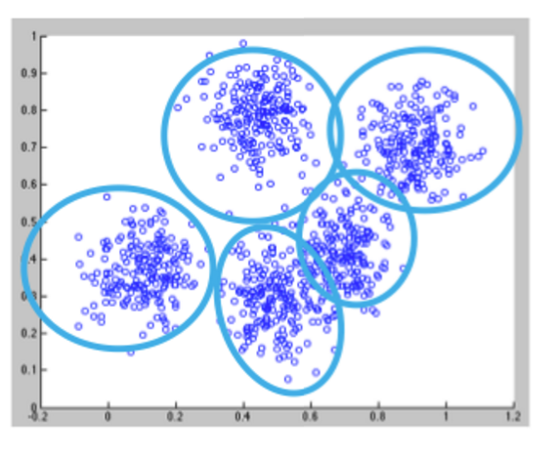
Types of Machine Learning
Unsupervised Learning
Clustering
Dimensionality Reduction
Association Rules
Unsupervised Learning
Clustering
Dimensionality Reduction
Association Rules
Clustering is used to automatically discovering structure in data, by grouping items in relevant way.
Clustering Applications
Customer Segmentation.
Documents Segmentation.
Image Processing

Slide 8
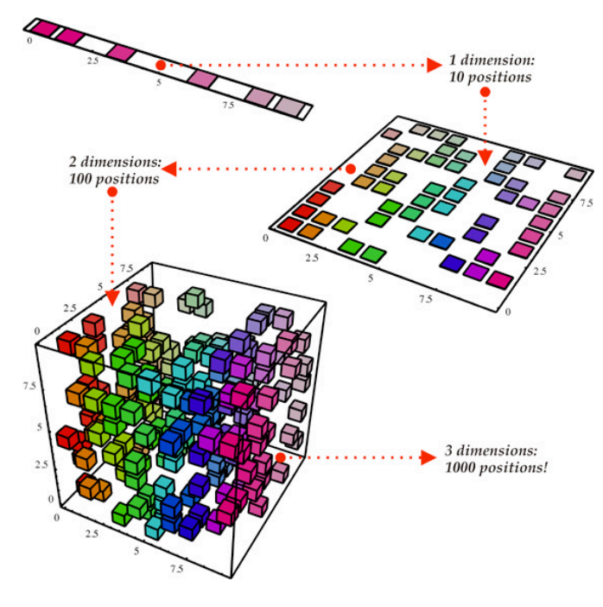
Types of Machine Learning
Unsupervised Learning
Clustering
Dimensionality Reduction
Association Rules
Unsupervised Learning
Clustering
Dimensionality Reduction
Association Rules
Dimensionality Reduction is the process of reducing the number of random variables under consideration, by obtaining a set of principal variables.
In other words describe the data with fewer dimensions without losing much of the meaning of the data.
Dimensionality Reduction Applications:
Meaningful compression
Big data visitation
Feature elicitation
Structure discovery
Notes:
In machine learning classification problems, there are often too many factors on the basis of which the final classification is done. These factors are basically variables called features. The higher the number of features, the harder it gets to visualize the training set and then work on it. Sometimes, most of these features are correlated, and hence redundant. This is where dimensionality reduction algorithms come into play

Slide 9
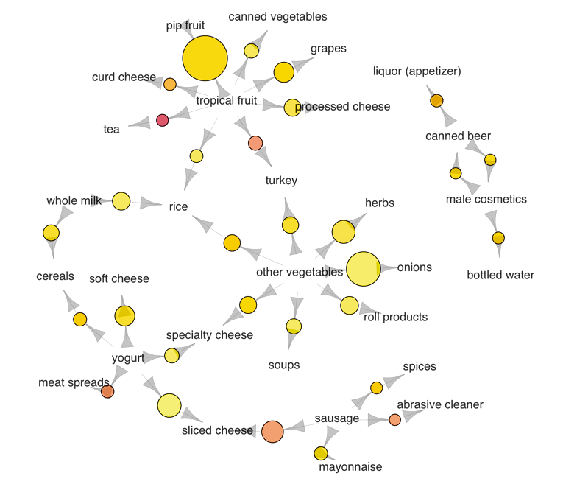
Types of Machine Learning
Unsupervised Learning
Clustering
Dimensionality Reduction
Association Rules
Unsupervised Learning
Clustering
Dimensionality Reduction
Association Rules
Association rules: Association rules are created by analyzing data for frequent if/then patterns and using the criteria support and confidence to identify the most important relationships.
Association rules applications:
Market Basket Analysis
Medical Diagnosis
Protein Sequen
Notes:
In machine learning classification problems, there are often too many factors on the basis of which the final classification is done. These factors are basically variables called features. The higher the number of features, the harder it gets to visualize the training set and then work on it. Sometimes, most of these features are correlated, and hence redundant. This is where dimensionality reduction algorithms come into play

Slide 10
Types of Machine Learning
Classification
Regression
Supervised Learning
Unsupervised Learning
Clustering
Dimensionality Reduction
Association Rules
Machine Learning
Reinforcement Learning
Semi supervised Learning

Slide 11
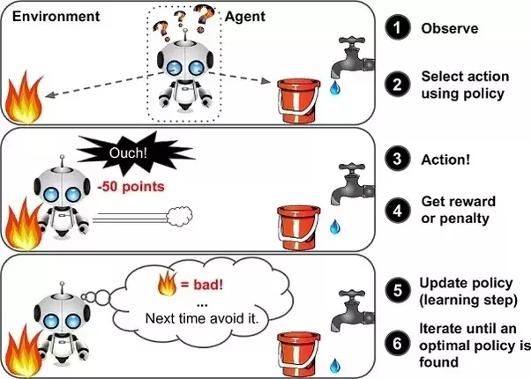
Types of Machine Learning
Classification
Regression
Supervised Learning
Unsupervised Learning
Clustering
Dimensionality Reduction
Association Rules
Reinforcement learning main task is to learn how to behave successfully to achieve a goal while interacting with an external environment.. (i.e. Learn via experience)
Reinforcement learning applications:
AI games
Real-time decisions: Supervised time series models can be used for predicting future sales as well as predicting stock prices.
Robot navigation: self-driving cars
in NLP: can be used in text summarization, question answering, and machine translation
Machine Learning
Semi supervised Learning
Reinforcement Learning

Slide 12
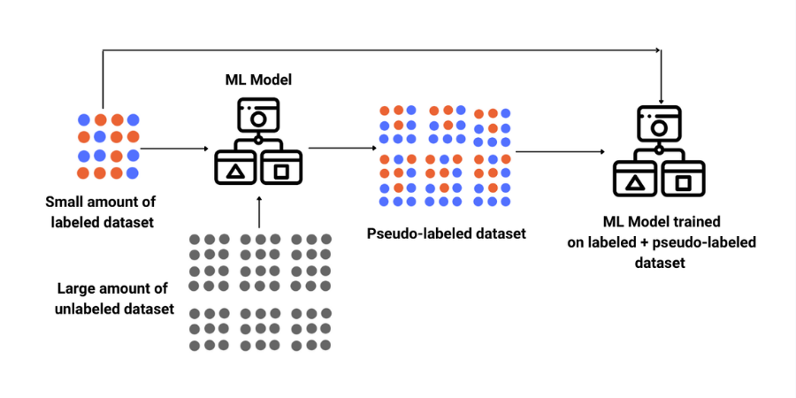
Types of Machine Learning
Classification
Regression
Supervised Learning
Unsupervised Learning
Clustering
Dimensionality Reduction
Association Rules
Semi supervised Learning: aka. weakly supervised learning
Semi-supervised learning falls between unsupervised learning (without any labeled training data) and supervised learning (with completely labeled training data).
Some of the training examples are missing training labels, yet many machine-learning researchers have found that unlabeled data, when used in conjunction with a small amount of labeled data, can produce a considerable improvement in learning accuracy.
Usually, the training labels are noisy, limited, or imprecise; however, these labels are often cheaper to obtain, resulting in larger effective training sets.
Machine Learning
Semi supervised Learning
Reinforcement Learning

Slide 13
Types of Machine Learning
Classification
Regression
Supervised Learning
Unsupervised Learning
Clustering
Dimensionality Reduction
Association Rules
Machine Learning
Reinforcement Learning
Semi supervised Learning

Slide 14
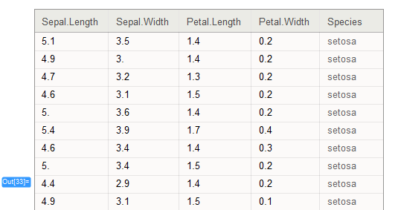
Machine Learning Terminology
Features
Output
Training dataset
Feature (a.k.a. input, variable …)
Output (a.k.a. target, label, class…)
Training instance (aka observation, row)
Training (a.k.a. learning, modeling, fitting)
Model validation and testing
Instance

Slide 15
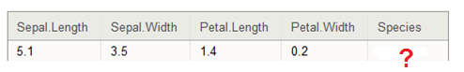

Machine learning process
Training
New Instance
Model
Result

Slide 16
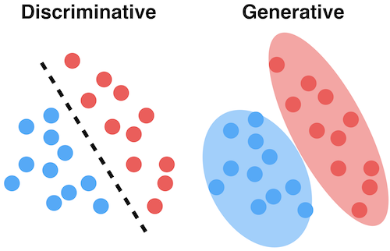
Generative vs. Discriminative Models
Two different approaches to machine learning models:
A Discriminative model ‌models the decision boundary between the classes.
A discriminative model focuses on predicting the labels of the data.
Discriminative model ‌learns the conditional probability distribution p(y|x).
Discriminative Classifiers: ‌Logistic regression, Support Vector Machine, ‌Traditional neural networks, ‌Nearest neighbors, Conditional Random Fields (CRF)s
A Generative Model ‌explicitly models the actual distribution of each class.
A generative model explains how the data was generated.
A Generative Model ‌learns the joint probability distribution p(x,y).
Generative classifiers: ‌Naïve Bayes, Bayesian networks, Markov random fields, ‌Hidden Markov Models (HMM)

Slide 17
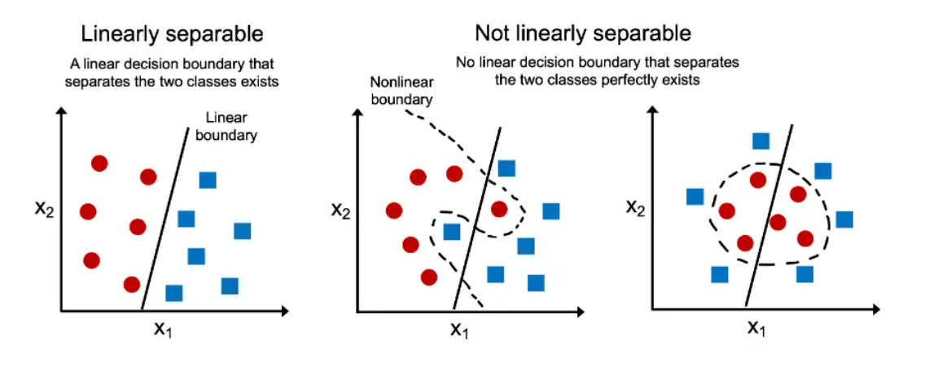
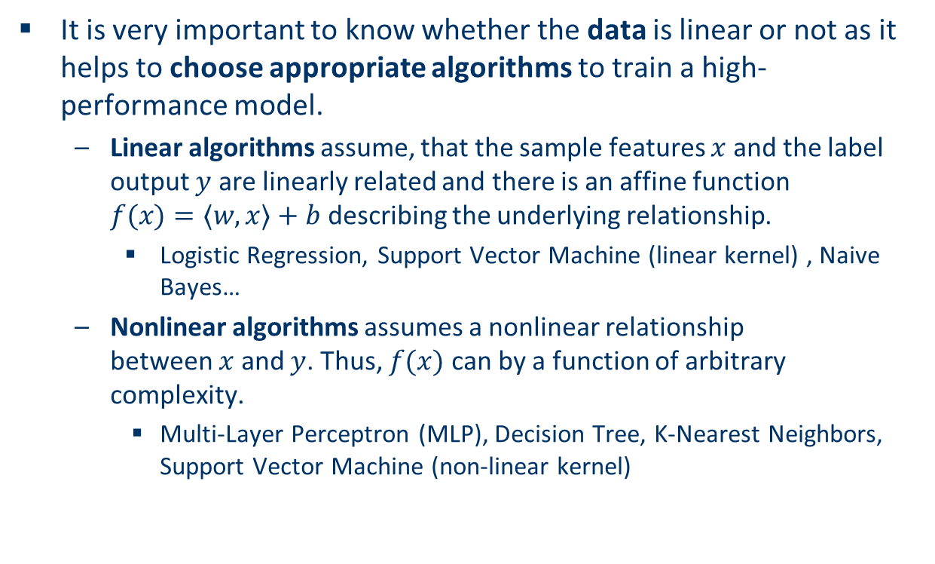
Linear vs Non-linear Data
It is very important to know whether the data is linear or not as it helps to choose appropriate algorithms to train a high-performance model.
Linear algorithms assume, that the sample features $x$ and the label output $y$ are linearly related and there is an affine function $f(x)=⟨w,x⟩+b$ describing the underlying relationship.
Logistic Regression, Support Vector Machine (linear kernel) , Naive Bayes…
Nonlinear algorithms assumes a nonlinear relationship between $x$ and $y$. Thus, $f(x)$ can by a function of arbitrary complexity.
Multi-Layer Perceptron (MLP), Decision Tree, K-Nearest Neighbors, Support Vector Machine (non-linear kernel)

Slide 18


